Slide 1
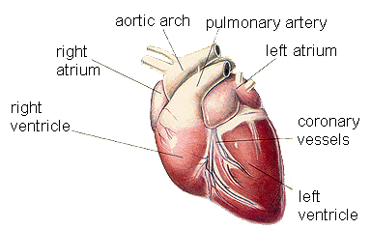
Cardiovascular system

Slide 2
A Cardiovascular system :
Composed of the heart , a muscular organ that pumps the blood into two separated circuits ; the pulmonary circuit which carry the blood to and from the lungs , and systemic circuit which distribute the blood to and from all of the organs and tissues of body

Slide 3
Structure of the wall of blood vessels:
The wall of blood vessel formed of three coats or tunics, each coat is formed from three elements from inside to outside.
1 – Tunica intima : the inner coat formed from three elements :
a – Endothelium : simple squamous cells .
b – Subendothelium : thin connective tissue layer below the endothelium .
c – Internal elastic lamina : an elastic membrane which lies to the outside of the subendothelial connective tissue layer and separates the intima from the media .2 – Tunica media (the middle coat )
Is also formed of three elements :
a – Mainly smooth muscle fibers arranged circularly .
b – Scattered elastic fibers
c – Fine collagenous fibers .
3 – Tunica adventitia : ( the outer coat ) is also formed of three elements :
a – mainly collagenous fibers .
b – few elastic fibers .
c- connective tissue cells .

Slide 4
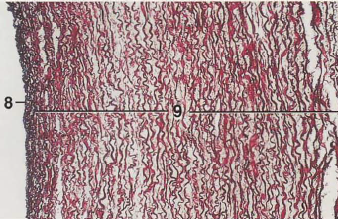
Large artery ( Aorta )
1 – Has a wide lumen ( compared to thickness of wall )
2 – Tunica intima relatively thick .
3 – Tunica media forms the main thickness of the wall .
4 – The adventitia connective tissue is thin

Slide 5
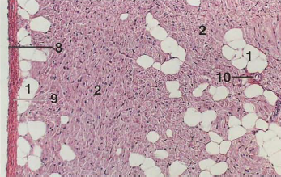
Large vein ( Vena cava )
1 – There is no internal elastic lamina.
2 – Tunica media is thin (some time absent)
3 – Tunica adventitia is very thick forming the main thickness of wall.
4 – There are longitudinal bundles of smooth muscle fibers in the adventitia.
Vasa Vasorum :
Are small arteries that enter the large vessels wall and branch profusely to serve the cells located in tunica media and adventitia, vasa vasorum are more in the walls of veins than arteries

Slide 6
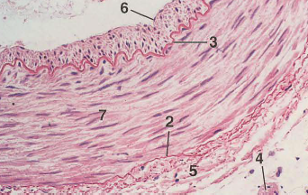
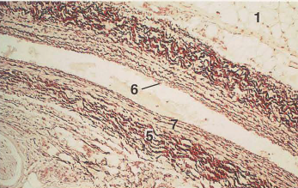
Medium size artery :
1 – Has thick wall compared with lumen .
2 – Intima thick ,folded and has well developed internal elastic lamina .
3 – The media is thick, the adventitia relatively is thin both media and adventitia contain elastic fibers.
4 – The lumen usually collapsed
Medium sized vein :
1 – Has a thin wall compared to its wide lumen .
2 – Intema is thin , not folded and has no internal elastic lamina .
3 – The media is thin , the adventitia thick and rich in collagenous fibers .
4 – Lumen appear usually collapsed

Slide 7
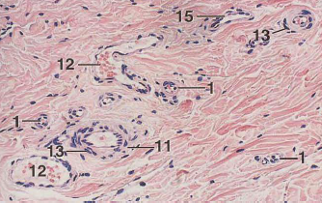
Arterioles :
Are the terminal arterial vessels , that regulate blood flow into the capillaries . The endothelium of tunica intima supported by thin subendothelial connective tissue , have thin internal elastic lamina and absent in small arterioles .
In small arterioles the tunica media is composed of single smooth muscle cells layer that completely encircle the endothelium .in large arterioles tunica media 2-3 layer of smooth muscles .The tunica adventitia is represented by fibro elastic connective tissue

Slide 8
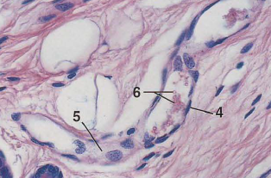
venule
venules have one or two
layers of smooth muscle that constitute a tunica media.
These vessels also have a thin tunica adventitia.

Slide 9
Capillaries ;
Are the smallest blood vessels , composed of single layer of squemous endothelial cells . The endothelial cells are flattened and the nuclei are bulges out into the lumen of capillaries .
Electron microscope have reveled 4 types of capillaries :
1 – continuous or somatic capillaries .(lung , muscle )
2 – Fenestrated or visceral capillaries ( with diaphragm ).
3 - Fenestrated or visceral capillaries ( without diaphragm ).
4 – Discontinuous sinusoidal capillaries .(Adrenal , pituitary , liver

Slide 10
capillaries

Slide 11
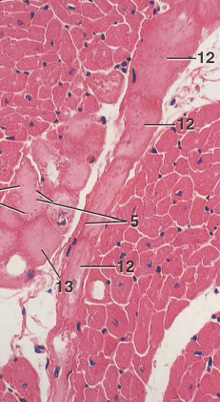
Heart :
The heart is a muscular organ that contract to pumping the blood through the circulatory system . It is also responsible for producing hormone called atrial natriuratic factor . It walls consist of three tunics :
1 – Internal ( endocardium )
2 –Middle ( Myocardium )
3 – External ( pericardium )
The fibrous central region of heart , called fibrous skeleton ,serves as the base of the valves as well as the site of origin and insertion of the cardiac muscle cells

Slide 12
The endocardium is homologous with the intima of blood vessels , it consist of single layer of squamous endothelial cells resting on a thin subendothelial layer of loose connective tissue that contain elastic and collagen fibers as well as some smooth muscle cells . connecting the myocardium to the subendothelial layer is a layer of connective tissue called subendocardium , that contains veins , nerves and branches of the impulse conducting system ( purkinje cells ).
The myocardium is the thickest of the tunics of heart and consist of cardiac muscle cells arranged in layer, a large number of these layers insert themselves into the fibrous cardiac skeleton .
The heart is covered externally by simple squamous epithelium supported by athin layer c.t.that constitutes the epicardium .
The epicardium corresponds the visceral layer of the pericardium , between the visceral and parital layers of pericardium there is small amount of fluid .

Slide 13
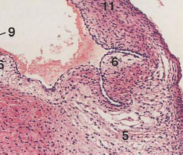
The cardiac valves
The cardiac valves consist of core of dense fibrous connective tissue , lined on both sides by endothelial layers,

Slide 14
Impulse conducting system :
It is specialized system to generate a rhythmic stimulus that is spread to the entire myocardium , its consist of sino-atrial node and atrio-ventricular node and atrioventricular bundle which originate from same node and branched to both ventricles . The sinoatrial node cells is modified cardiac muscles cells fusiform and smaller than atrial muscles , and have few amount of myofibrils , purkinje cells : larger than ordinary cardiac muscle cells , have two or one nuclei and their cytoplasm is rich with mitochondria and glycogen, the myofibrils peripherally located .

